Slide 1

Oceans on a Shoestring: Shape Representation, Meshing and Shading
Huw Bowles
Studio Gobo

Slide 2


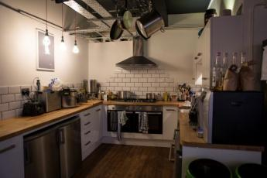
Introduction
Notes:
Studio Gobo is a small team of talented developers based in Brighton / UK

Slide 3










The Crew
Ben Andrews, Paul Ayliffe, Anastasios Brakis, Jim Callin, Clement Dagneau
Kevin Hayes, Will Myles, Olliver Reid-Smith, Phil Williams, Tom Williams
Notes:
Some of the amazing people from Studio Gobo that contributed to this work, across code, art and design. There are additional people that made contributions to this work but can’t be named for legal reasons.

Slide 4
Introduction
Mystery Project X
Built a self contained part of the game
Includes a virtual ocean
Notes:
For legal reasons we are not allowed to disclose the name of the project we worked on, although the project (and our involvement in it) is already announced.

Slide 5
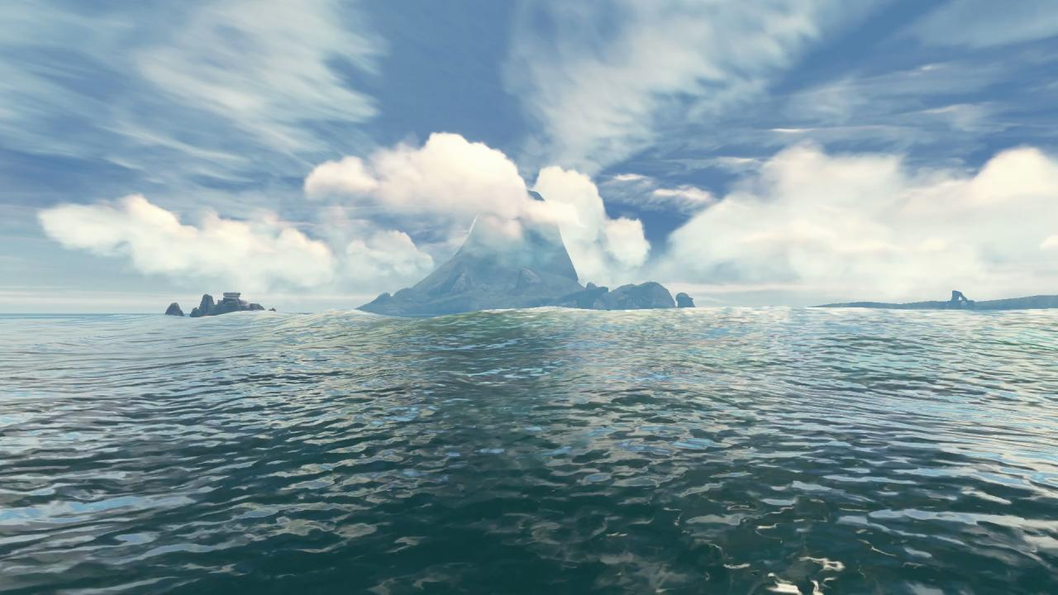
Demos
Notes:
This is what it looked like. This video should run smoothly at 30fps.

Slide 6
Introduction
Seamless experience across land and sea
Ocean is both a play space and a back drop
Various art and design goals
8 month development
Shipping platforms: Xbox 360, PS3, Wii
Notes:
Project timeline was tight so we aimed to develop one solution that worked on all shipping platforms. The GPU on the Wii is fixed function so we aimed to do a CPU solution

Slide 7
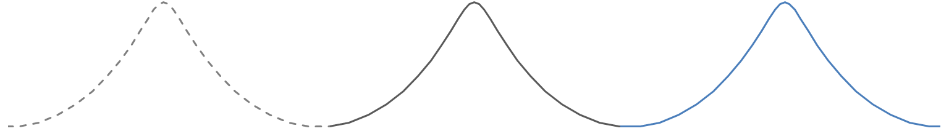
Overview
Shape
Meshing
Shading

Slide 8
Overview
Shape
Meshing
Shading
Notes:
To render an ocean you need three things. One is some kind of description of the shape. Secondly you need to sample the shape as a 3D mesh and submit it to the GPU.
Finally, shaders tell the GPU how to create the appearance of the ocean surface.

Slide 9
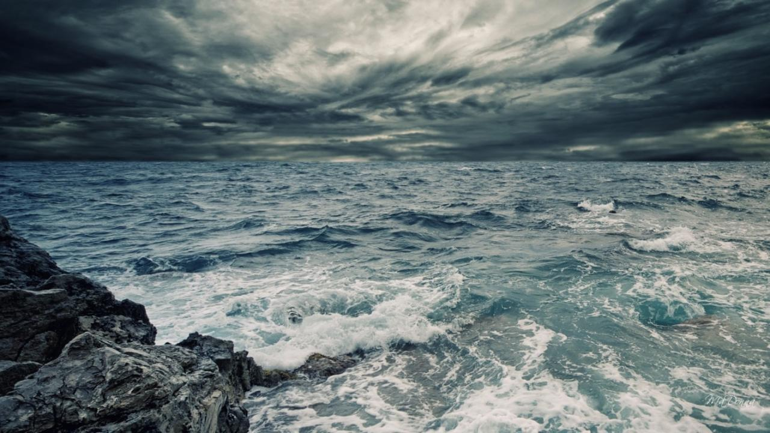
Shape
Notes:
Ocean surface is complex and detailed and at the same time vast. This makes it challenging to describe (compactly).

Slide 10
Shape
Global shape
Fourier Synthesis
Procedural representations
Local shape
Wave height modifiers
Wave particles
Notes:
Doing a full fluid sim is still out of reach for games.
Compress the shape by dividing it into two levels.
Global shape is the base ocean shape that is repeated over the entire ocean surface.
Local shape adds some localised deviation to the shape to meet art and design requirements.
Also normal maps are used to hallucinate high freq waves on the surface. We’ll look at these later.

Slide 11
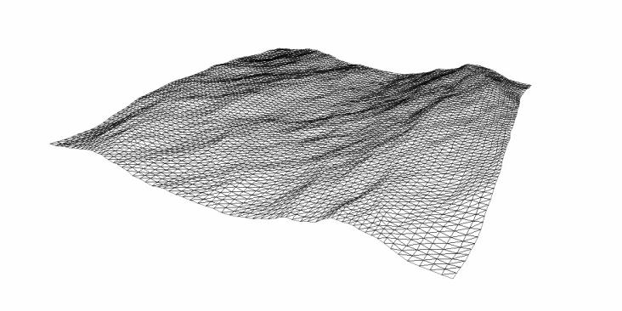
Shape / Fourier Synthesis
Notes:
Fourier synthesis generates something like this – a patch of our ocean surface.

Slide 12
Shape / Fourier Synthesis
Several models for the frequency content of ocean waves known
Can use Fourier Transform to synthesise surface with desired spectrum
See the work from [Tessendorf2001]
Notes:
Can limit the frequencies so we get a tileable, loopable patch.

Slide 13
Shape / Fourier Synthesis
We used this for Xbox 360 and PS3
Precompute FFT offline into set of displacement maps [Torres2012]
64 frames looping animation, 64x64 spatial resolution, 8bit fixed point values
1.5mb for positions and normals
Notes:
Some implementation details.
Fixed point values – 8bit seemed to be enough precision to store the displacement map. We did the interpolation of data also using fixed point math and then converted to floats afterwards.
We did all this on the CPU.
I guess, if this is done by sampling textures in the vertex shader, mipmapping will automatically filter out high frequencies (if mip maps are enabled?)?

Slide 14
Shape / Fourier Synthesis
Too much memory for Wii (64mb RAM)
Look at procedural representations
Sum a set of waves
Notes:
Memory is precious on Wii. We decided to look at procedural representations that do not rely on prebaked data.

Slide 15
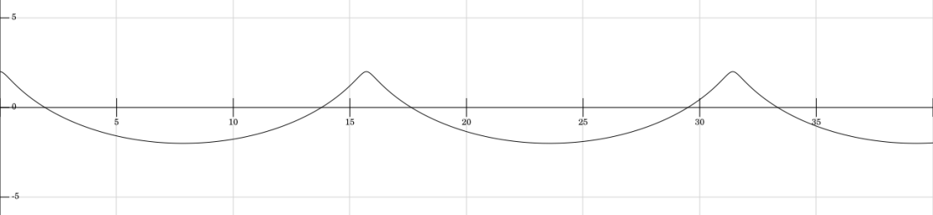
Shape / Trochoids
Trochoid curves (A.K.A. Gerstner waves)
Approximates shape of deep sea waves well
Notes:
Standard shape for deep ocean waves (waves not influenced by ocean floor).
Trochoids are nice – peaks/crests are important for visual interest.
More info: http://whatonearth.olehnielsen.dk/oceanwaves.asp

Slide 16
Shape / Trochoids
Cannot sample wave height directly (see appendix)
Approximate trochoids instead with polynomial equation
Notes:
Trochoid is a parametric equation. The parameter can’t be solved for a particular point in space algebraically. While it can be solved iteratively using fixed point iteration, we decided to approximate the trochoid shape with a piecewise polynomial.

Slide 17
Shape / Parabolic waves
Notes:
This is the shape we settled on

Slide 18
Shape / Parabolic waves
Notes:
Its constructed by adding three parabolas

Slide 19
Shape / Parabolic waves
Cap
width
Notes:
One parameter – cap width – gives sharpness of peak.

Slide 20
Shape / Parabolic waves
Notes:
Can tweak sharpness. Could reduce sharpness towards distance to remove high frequencies but we didn’t have time to experiment with this too much.

Slide 21
Shape / Parabolic waves
Notes:
Can get a close fit to trochoid if we choose.
For our purposes we tweaked the crest to be as sharp as possible without causing too much interpolation error and/or aliasing.
On wii we summed together three of these waves, travelling at slightly different speeds and directions, which gives a low definition surface but without noticeable repeating in our experience.

Slide 22
Shape
Global shape
Fourier Synthesis
Procedural representations
Local shape
Wave height modifiers
Wave particles
Notes:
Next we want to sprinkle in some local detail.

Slide 23
Shape / Wave Height Mods
Spheres placed in world to influence waves
Ramp waves down in bays/around islands
Ramp waves up in storms
Notes:
Simple solution to control wave heights.
A wave height mod has 2 radii. Influence blended from 0 to 1 between outer and inner edge.
Could be done with wave particles but its useful to have two radii, and the operation is an alpha blend as opposed to additive blend.

Slide 24
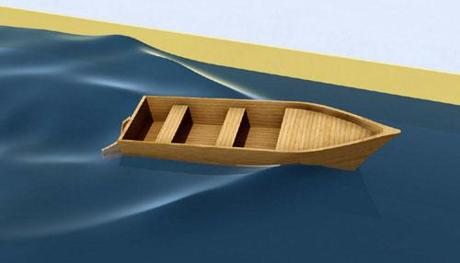
Shape / Wave Particles
Wave Particles introduced by [Yuksel2007]
“Blobs” of water that move over the surface
Source: [Yuksel2007]
Notes:
The second way we add local detail is using wave particles.

Slide 25
Shape / Wave Particles
Contribute both surface height and foam values for shading
Can be either free-moving or tethered to floating objects
Notes:
In our implementation the wave particles contributed both water volume and foam values
We tethered foam wave particles to floating objects to help them connect with the surface. Moving objects also generated a wake simply by spawning wave particles moving outwards from the object and scaling the wave particle height by the velocity. In the paper from Yuksel they preserve water volume which is nice.

Slide 26
Shape / Wave Particles
We use smoothstep as the particle kernel
Cross section shown below
Notes:
Here is a cross section profile of a single wave particle. Yuksel et al. use a cosine curve to give the wave shape. We use the smoothstep function. This allowed us to factor out some terms and use in both the height and derivative computation.

Slide 27
Shape / Wave Particles
Can offset parameter to get ripples ☺
Notes:
We can do a symmetrical parameter offset to get a donut shape i.e. a ripple.
This is novel as far as we know.
Could probably get a train of ripples by transforming the wave particle parameter.
See the appendix for equations.

Slide 28
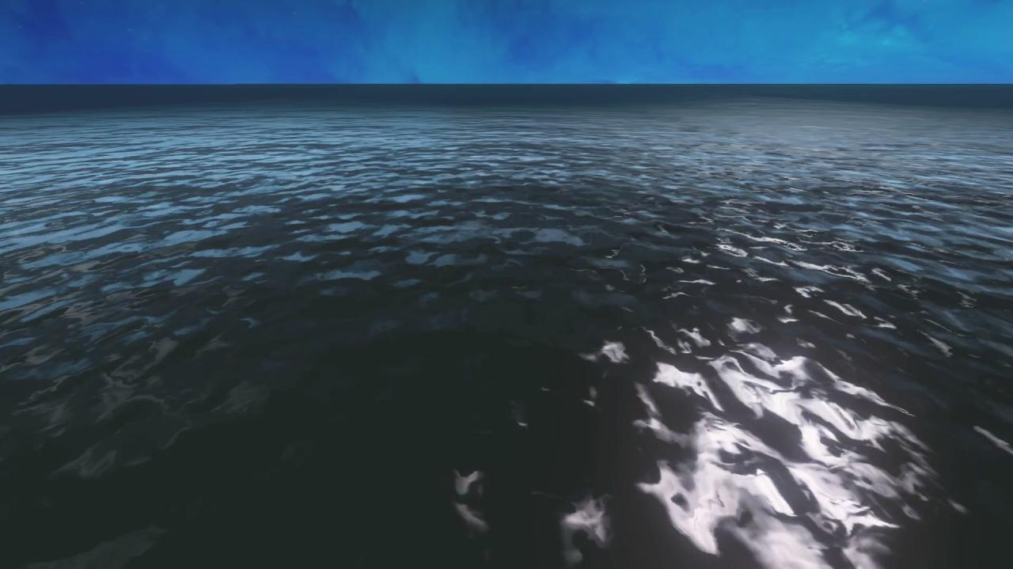
Shape / Wave Particles
Notes:
Using positive ripple only – would be best to follow it with a negative ripple.
Could probably get a train of ripples by transforming the wave particle parameter.
Insert sea monster here

Slide 29

Shape / Wave Particles
World axis-aligned uniform grid for queries
Write active particles into grid after update
Simple loop to rasterize ripples onto grid
Notes:
To efficiently evaluate the shape contributed by wave particles, we need a fast way to query them.
Use uniform grid.
Rasterize all possible cells, so that lookup is a single query. This however means that the bucket sizes in the uniform grid have to be larger as every WP is written to 9 cells.
Would have been best to have multiple grids to allow for different wave particle kernel widths (a uniform grid with cell width c imposes a maximum wave particle kernel radius of c). We ran out of time here ☹

Slide 30
Shape / LOD
Limited number of samples
Especially when meshing on the CPU
Notes:
We want to use shape judiciously. We’ll have a very limited number of samples later.
Insufficient sampling leads to large interpolation error and possibly aliasing.

Slide 31
Shape / LOD
Avoid shape where it is not apparent
View dependent
Notes:
We really need to be economical on shape.

Slide 32
Shape / LOD
Procedural – omit smaller wavelengths
Fourier synthesis – ramp down
Wave particles – ramp down
Notes:
We only introduce shape close to the viewer. Shape is removed in these ways. For the procedural approach we could also make waves smoother (crests less sharp).
Ramping down/scaling does not solve undersampling/aliasing, but reduces the magnitude of the error
Proper filtering of fourier synthesised surface patches could be performed if we did meshing on the GPU and we were willing to pay for mipmaps.

Slide 33
Shape / Summary
Many ways to describe shape
We found the discussed methods to be
Expressive
Relatively quick and easy to implement

Slide 34
Overview
Shape
Meshing
Shading
Notes:
There are many other ways that shape could be described. Could for example have repeated the input coordinate to get a chain or ripples from one wave particle. We found the previous were quick and easy to implement, efficient to compute and gave us a reasonable amount of expressive power.
Now that we have the shape, we want to sample it to generate the mesh.

Slide 35
Meshing
Need a set of sample positions
Triangulate to get surface

Slide 36
Meshing
We want to adapt meshing to shape
Globally
View dependent sampling
Locally
Pinch verts at wave crests and wave particles
See appendix
Notes:
Also ideally we would get alignment of mesh edges with edges/corners of the shape. It seems like there are ways to adjust the topology based on wave direction to get a better alignment of edges to the shape but we didn’t do anything here.

Slide 37
Meshing
We want to adapt meshing to shape
Globally
View dependent sampling
Locally
Pinch verts at wave crests and wave particles
See appendix
Notes:
Mesh needs to match shape
Globally – concentrate verts around the viewer where the shape is
Locally – we can also concentrate verts based on local frequency content of shape. See appendix for some strategies.

Slide 38
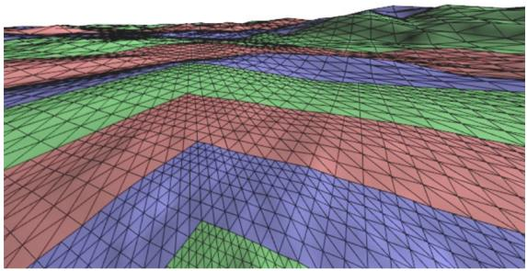
Meshing / Clipmapping
Sew different resolution grids together
Source: [Losasso2004]
Notes:
Mesh verts almost completely stationary (bar some blending between detail levels)

Slide 39
Meshing / Clipmapping
Sew different resolution grids together
Ruled out during preproduction
Future work: proper comparison
Notes:
We ruled this out during preproduction based on some guesses about implementation difficulty and runtime efficiency. I don’t have evidence to confirm this though. And it has shipped in AAA titles [Ochoa2012], I believe CryEngine uses it too – TODO dig up presentation (http://www.crytek.com/cryengine/presentations )
An interesting contribution would be to compare the two using some kind of suitable performance and quality metrics.

Slide 40
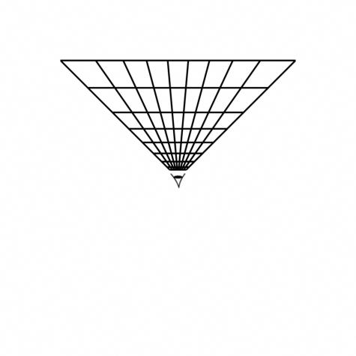
Meshing / Projected grid
Introduced by [Hinsinger2002]
Screen
World
Notes:
Instead we started with the projected grid method.
The idea with this method is to generate a mesh in screen space and then project it onto the ocean plane. Then the projected verts are then the sample points of the shape.

Slide 41
Meshing / Projected grid
Simple and cheap
View adaptive
Verts move with camera
Interpolation error becomes animated and noticeable
Notes:
Mesh moves with viewpoint so this method is prone to interpolation error.
I refer to this as interpolation error whereas it’s typically referred to as aliasing. I guess it is aliasing (from the triangle hat reconstruction filter?) but I’ll keep referring to it as interpolation error here.

Slide 42
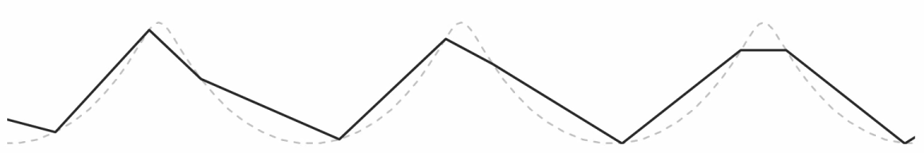
Meshing / Projected grid
Notes:
Here is what it looks like in motion. Note the rippling effect on the surface. And the height of the wave changes considerably depending on the samples.

Slide 43
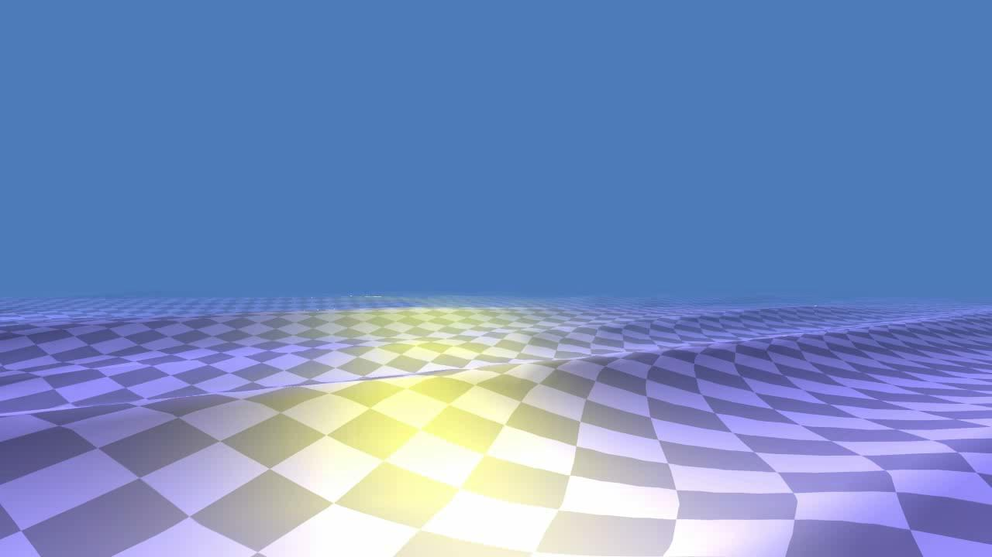
Notes:
Here is a 3d prototyping scene. It has 3 parabolic waves summed together (introduced earlier).
When the camera is stationary, nothing out of the ordinary.

Slide 44
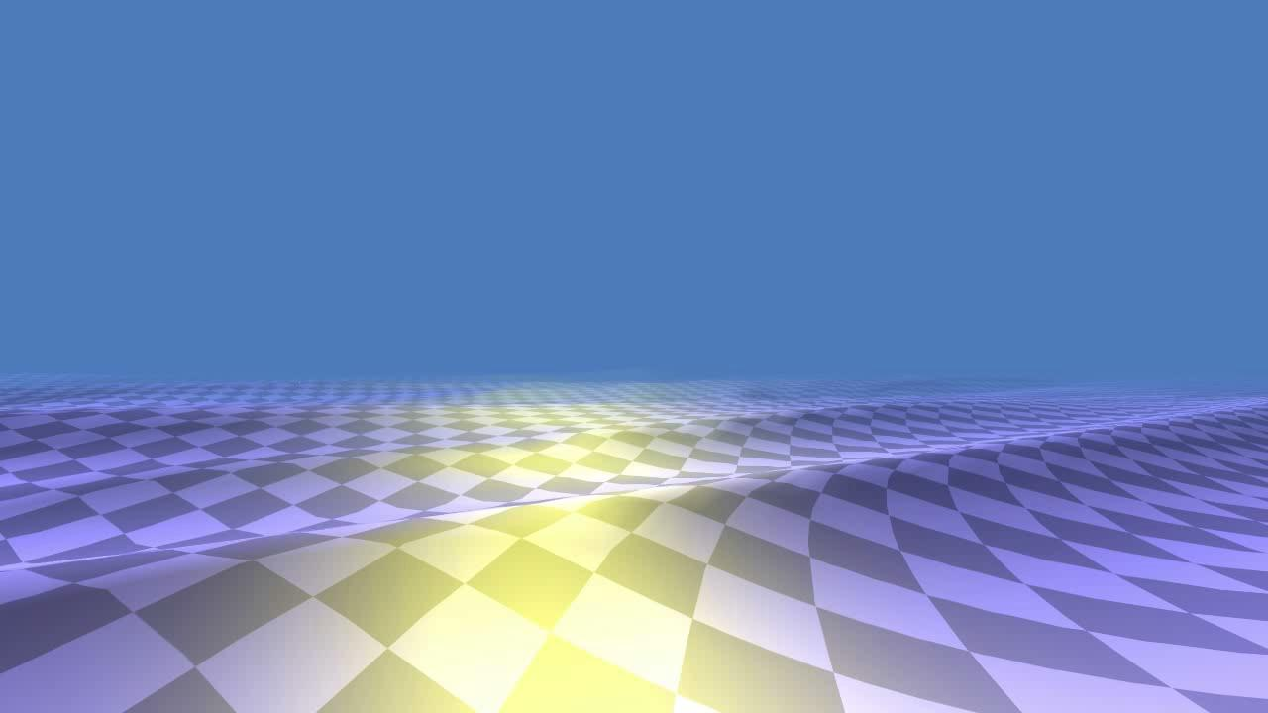
Notes:
Now freeze the ocean surface and move the camera.
The rippling artifacts are obvious.
Note that this error is still there when the camera is stationary! Its just not noticeable because the error is frozen.

Slide 45
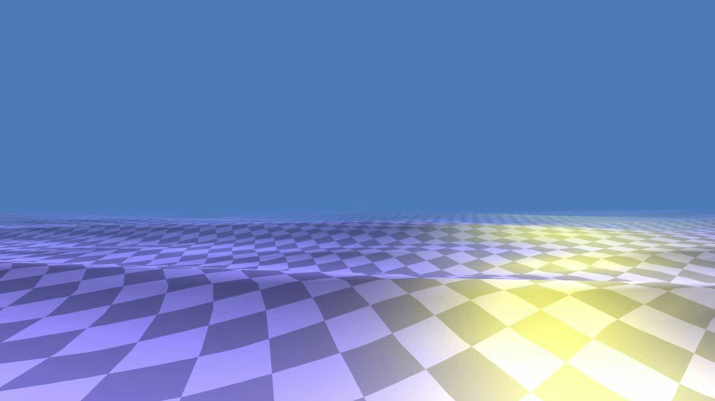
Notes:
Similar issues occur when rotating the camera. Most noticeable at sides of screen.

Slide 46
Meshing / Projected grid
If we can keep verts stationary, we can freeze interpolation error
Notes:
This is happening in the first video.

Slide 47
Meshing / Polar Meshing
We introduce Polar Meshing
Aims to keep vertices stationary in world space

Slide 48
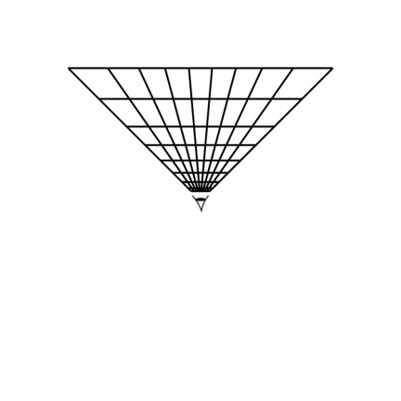
Meshing / Polar Meshing
Rotation

Slide 49
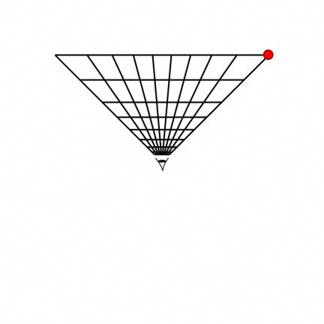
Meshing / Polar Meshing
Rotation

Slide 50
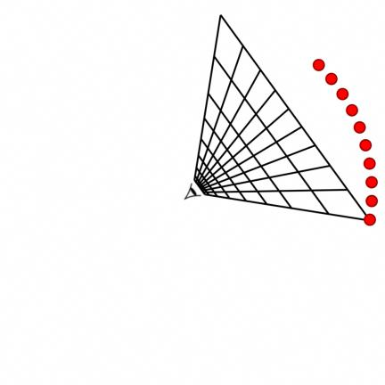
Meshing / Polar Meshing
Rotation
Notes:
This is the trace of an individual vert when the view is rotated. We want the verts to be as stationary as possible to avoid the animated interpolation error shown before.

Slide 51
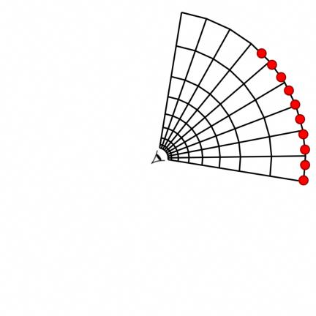
Meshing / Polar Meshing
Change shape to match vert flow
Notes:
Solution part 1: Change vert placement to match vert flow.
Instead of doing a strict screen space projection of a regular grid, we are moving into world space and constructing the mesh around the viewer.

Slide 52
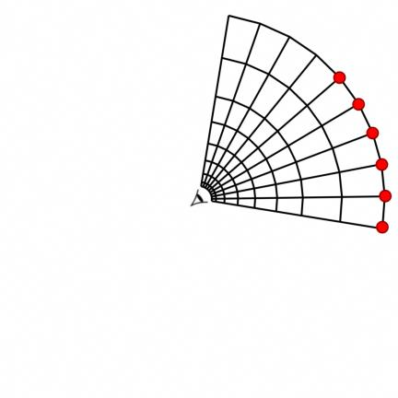
Meshing / Polar Meshing
Snap rotation
Notes:
Solution part 2: Snap mesh rotation to angular increments that match the mesh.

Slide 53
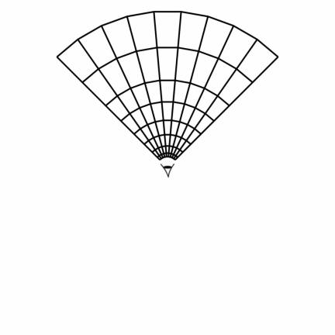
Meshing / Polar Meshing
Vert movement eliminated
Notes:
Result – completely stationary verts.

Slide 54
Notes:
Before (projected grid)

Slide 55
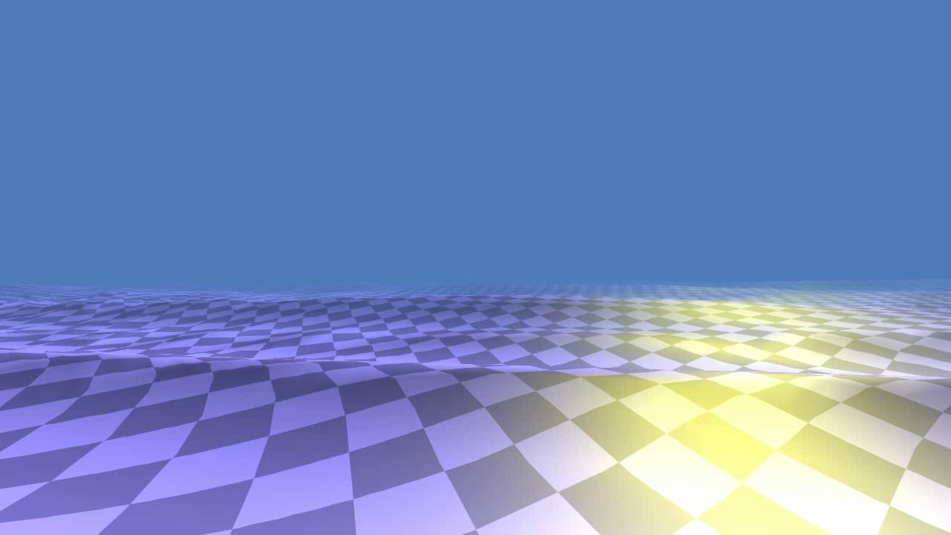
Notes:
After (polar meshing)

Slide 56
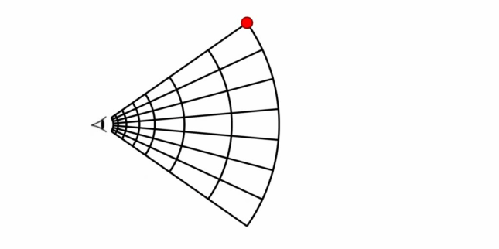
Meshing / Polar Meshing
Forwards motion

Slide 57
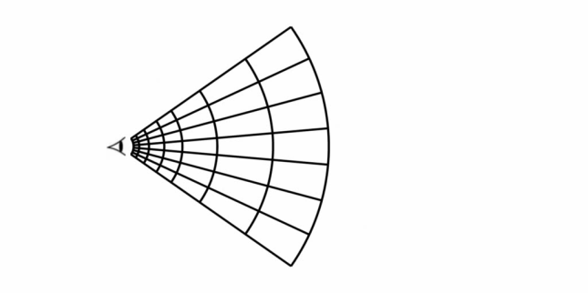
Meshing / Polar Meshing
Move vert rings inwards
Notes:
One idea would be to simply pull the vert ring radii inwards to compensate for some of the motion of the verts.
However we quickly lose the detail close to the viewer and end up with a very sparse mesh.

Slide 58
Meshing / Polar Meshing
Adaptive tessellation
How to organise split/merge events?
Notes:
So we would like to introduce detail as the mesh approaches the viewer by smoothly dividing vert rings.
Question – when and where do the splits occur?

Slide 59
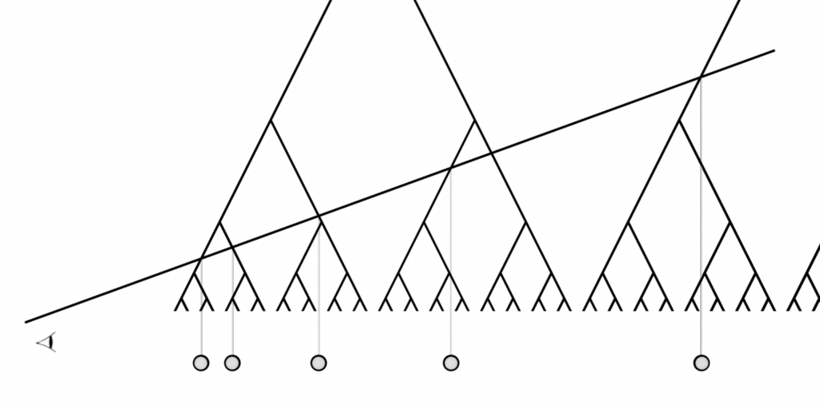
Meshing / Polar Meshing
Notes:
Idea: get ring radii by intersecting a line with a binary tree

Slide 60
Meshing / Polar Meshing
FAIL
Notes:
Unfortunately there is an issue with this diagram – one of the tree branches has been missed.

Slide 61
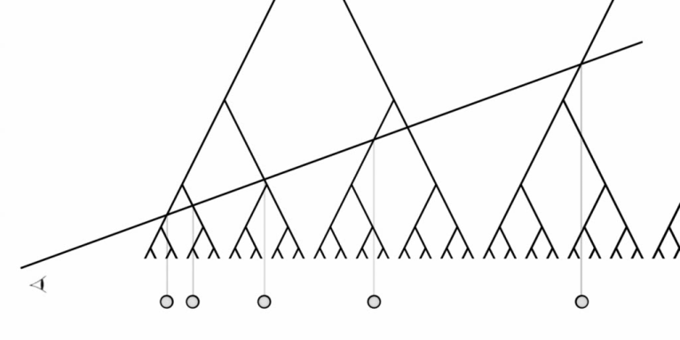
Meshing / Polar Meshing
Notes:
The reason we construct this structure becomes obvious when we move the viewer (and the line) forward. Note that the mesh subdivides as it approaches the viewer, while staying approximately stationary in the world.

Slide 62
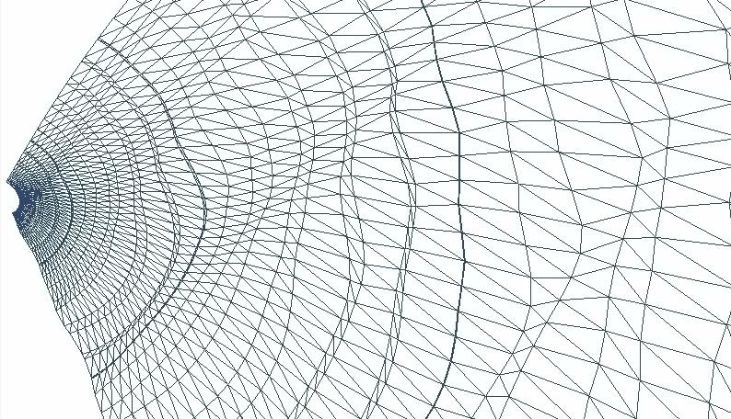
Meshing / Polar Meshing
Notes:
Here is a view of the mesh from above. The stationary arrow is useful for checking the motion of the vert rings.

Slide 63
Notes:
Before (projected grid)

Slide 64
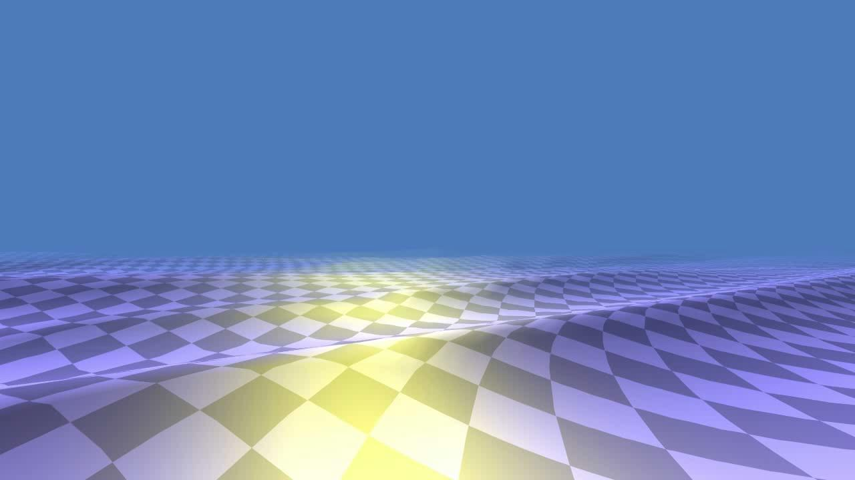
Notes:
After (polar meshing)

Slide 65
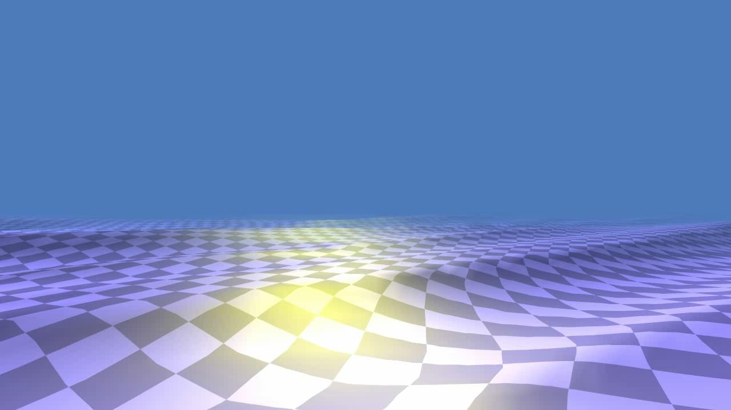
Notes:
Before animated

Slide 66
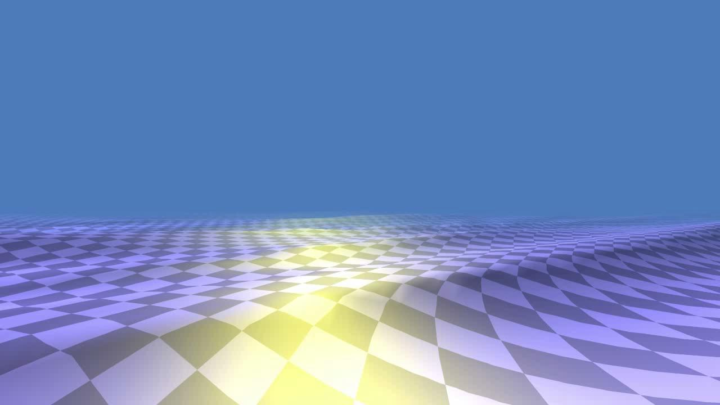
Notes:
After animated

Slide 67
Meshing / Polar Meshing
Idea: Intersect a “detail curve” with a binary tree
Binary tree compression, but interpolating between tree levels
Notes:
Recap.
Call the line a “detail curve”
We are doing something analogous to quad tree compression of e.g. images, but with smooth interpolation between tree levels.

Slide 68
Meshing / Polar Meshing
No tree traversal required
Structure of tree well defined and recursive
Notes:
Note however that no tree traversal in the traditional sense is required

Slide 69
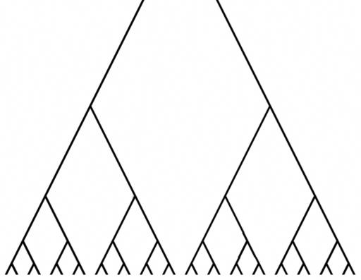
Meshing / Polar Meshing
Notes:
Walk down tree. Note that on each of the following slides the exact same problem is being solved, albeit at different positions and scales.

Slide 70
Meshing / Polar Meshing
Notes:
Same again, different location

Slide 71
Meshing / Polar Meshing
Notes:
Different scale and location

Slide 72
Meshing / Polar Meshing
Notes:
Different location (and so on…)

Slide 73
Meshing / Polar Meshing

Slide 74
Meshing / Polar Meshing

Slide 75
Meshing / Polar Meshing
Notes:
Final result.
Instead of walking the tree each time, could maintain a set of samples and update them each frame (join them if the cross a tree level from underneath, split if from above). This may be faster but probably more difficult to implement, and in reality we are looking for sqrt(N) intersections (where N is the number of verts in the mesh) which is a relatively small cost.

Slide 76
Meshing / Polar Meshing
Significantly reduce apparent artefacts
See appendix for practical considerations
Notes:
Polar meshing summary

Slide 77
Meshing / Polar Meshing
Xbox 360
Precomputed wave data (64x64, 64 frames)
40x40 grid
3.3ms without wave particles
Approx 6ms with wave particles
Moved onto different CPU hardware thread
Notes:
This is dated hardware. Running on a reasonably powerful PC this would be 1 or 2ms

Slide 78
Meshing / Polar Meshing
Wii
20x20 grid
Sum of 3 parabola waves
0.9ms without wave particles
Notes:
Scaled down well for wii.

Slide 79
Meshing / Summary
Introduced Polar Meshing
Cheap
Relatively easy to implement
Reduces visible error
More details in appendix

Slide 80
Overview
Shape
Meshing
Shading

Slide 81
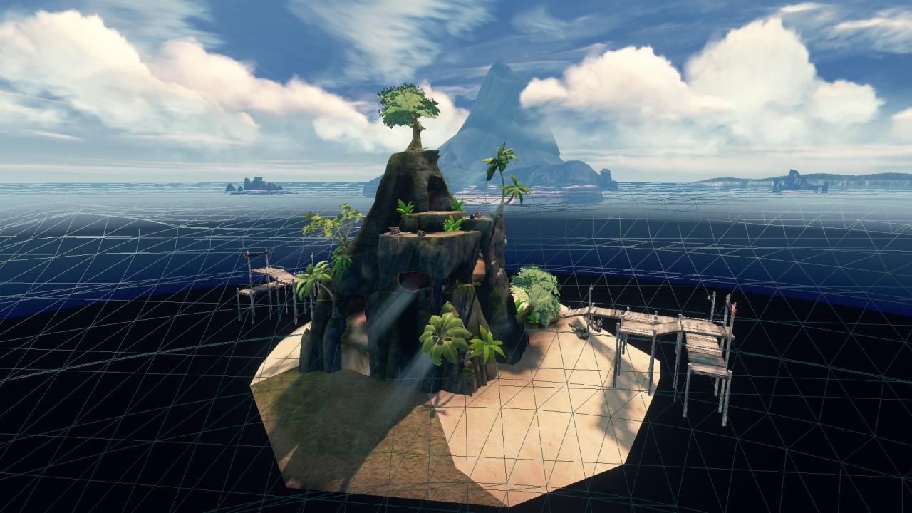
Shading / Composition
Foam
Notes:
Wireframe. Triangle strips. Topology (index buffer) was fixed in our implementation (topologically equivalent to a tessellated quad).
Long straight lines are degenerate triangles that act as strip terminators.
Note that the resolution of the mesh is relatively low, as we did meshing on the CPU we couldn’t afford much higher on console. Note also that the mesh detail is not evenly distributed in world space. This is partly due to a limitation with the tree-based meshing scheme that is detailed in the appendix.

Slide 82
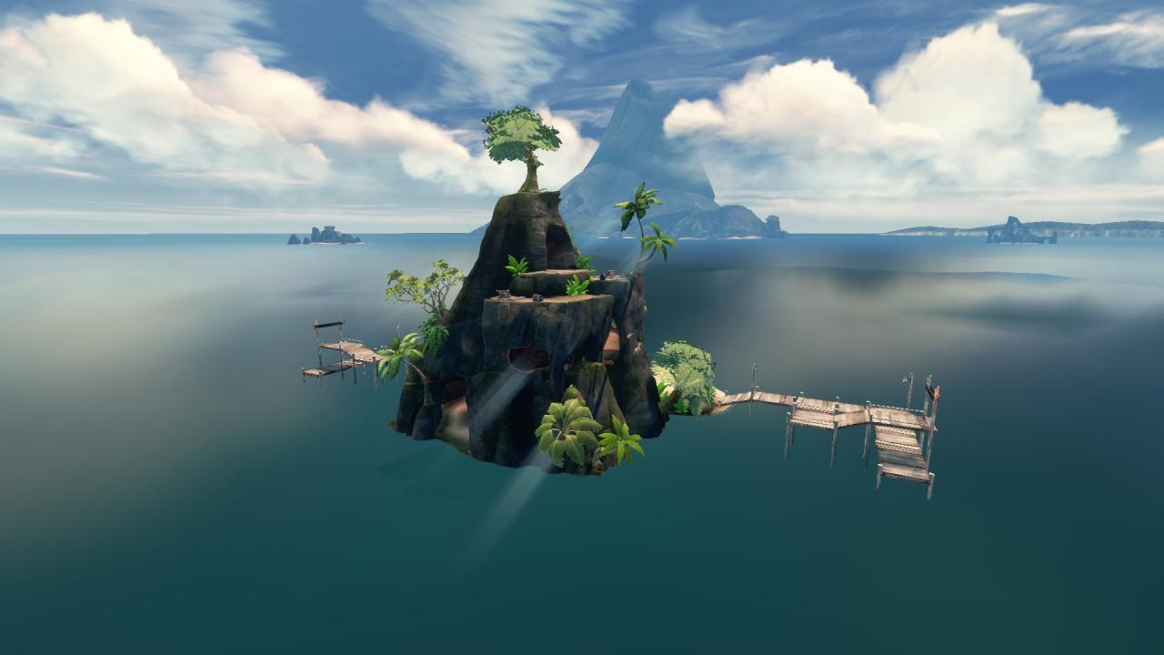
Shading / Composition
Foam
Notes:
A specular material showing the env map.

Slide 83
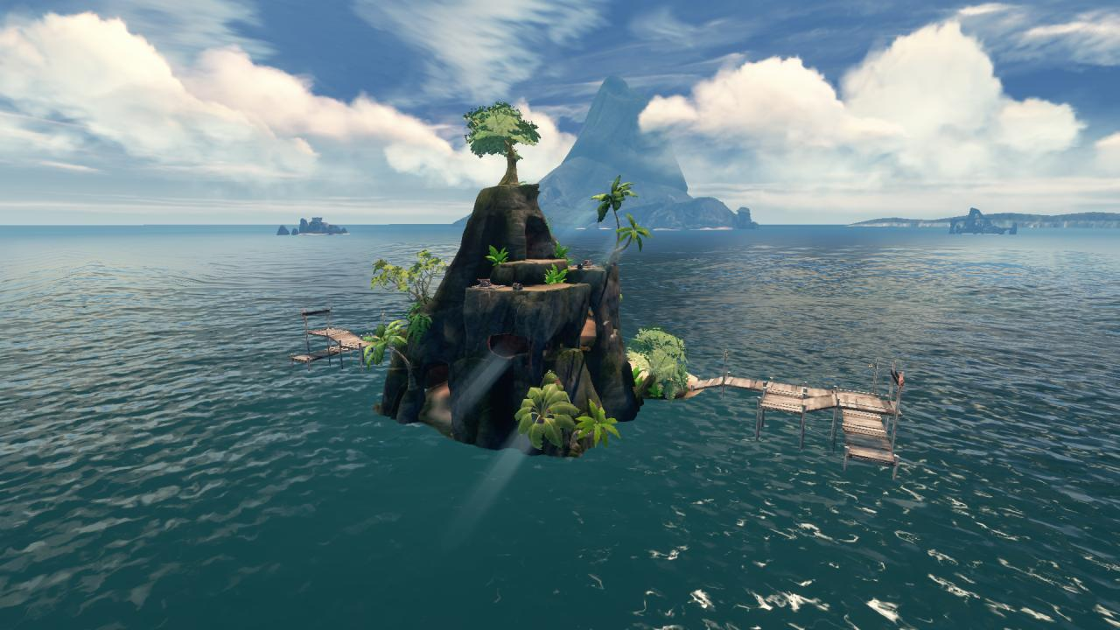
Shading / Composition
Foam
Notes:
Here 2 scrolling normal maps are used to add the appearance of high frequency waves on the surface.
We had some issues with the normal map detail being lost in the distance. There are some features in the engine to tackle this kind of loss of detail but it didn’t seem to be giving us good results and I didn’t have time to investigate in too much detail, so we simply blended in a third normals layer towards the distance that was stretched to a much larger scale, as shown on the next slide…

Slide 84
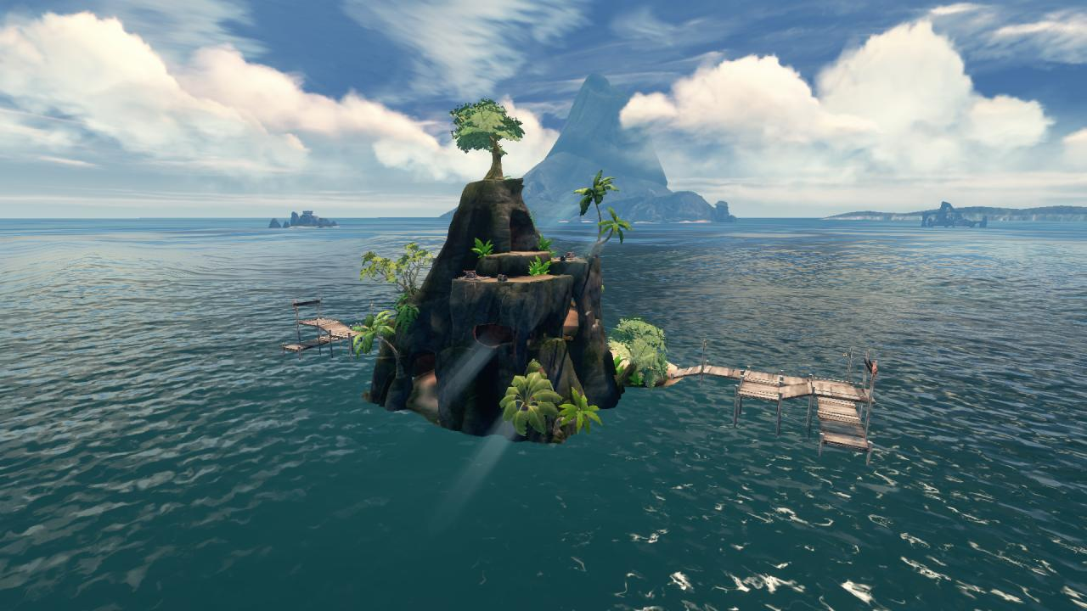
Shading / Composition
Foam
Notes:
Third normals layer.
We experimented with boosting low frequencies as they did for Journey [Edwards2012] but we had limited success, and it wasn’t easy to build a workflow for this due to practical reasons.

Slide 85

Shading / Composition
Foam
Notes:
Refraction (with fog)

Slide 86
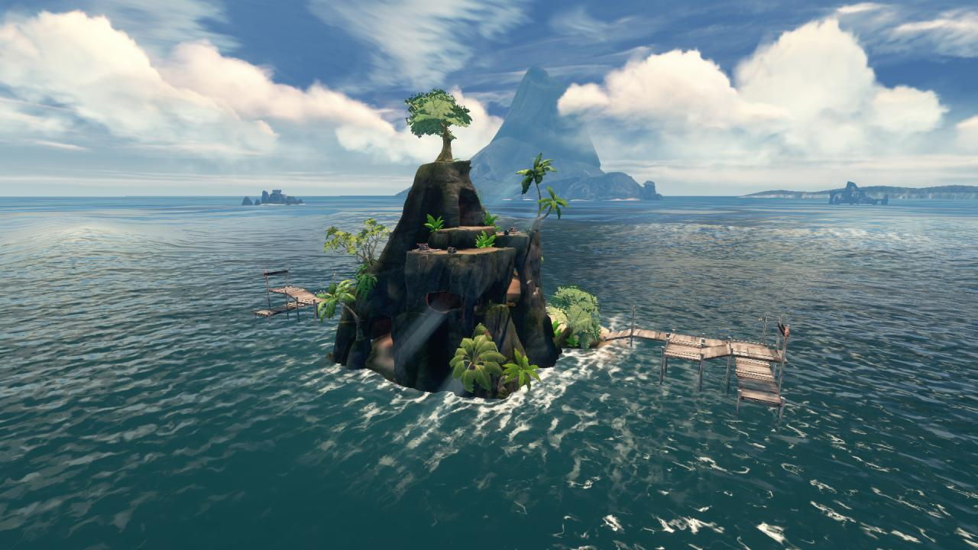
Shading / Composition
Foam
Notes:
Foam, fed by a coastal foam map around the island and by the wave data along the wave crests.

Slide 87
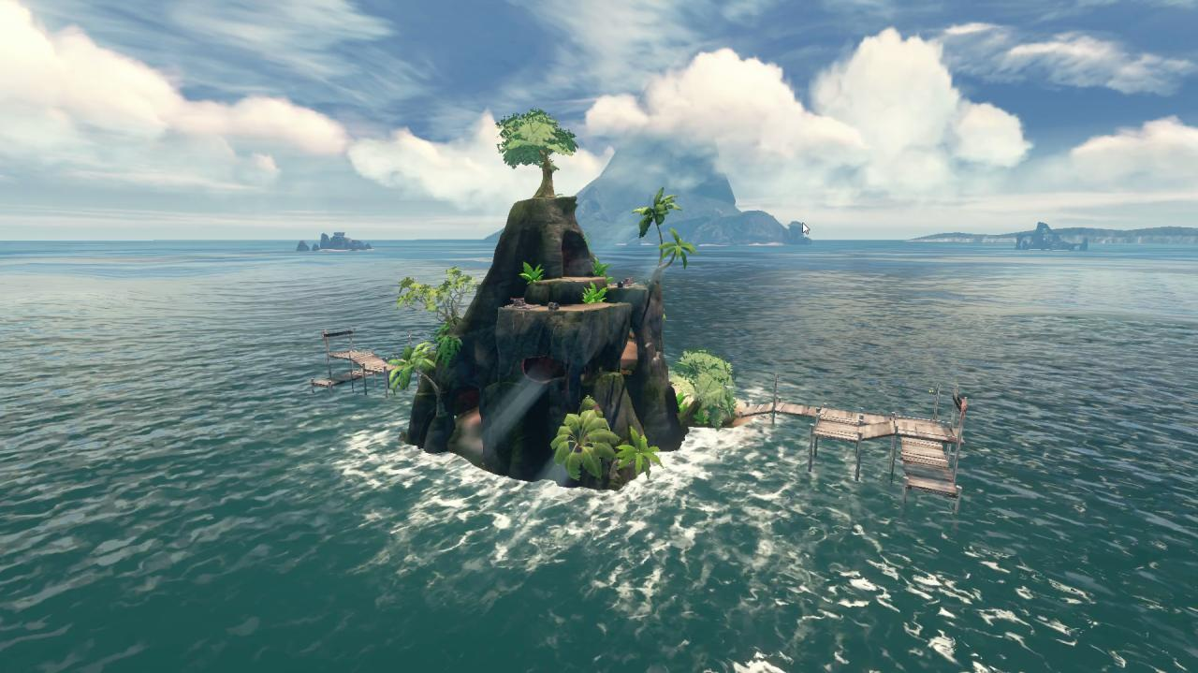
Shading / Foam
Notes:
In motion.

Slide 88
Shading / Foam
Per-Vertex data
Crests in wave data, detected by height and faded over time
Wave particles with foam values ☺
Per-Pixel data
Texture projected down onto world to get coasts
Notes:
Foam was fed by two sources of data
Vertex
Values computed from the wave data, detected by height and faded over the animation loop.
Collected from wave particles during mesh construction
Pixel
From a coastal foam map

Slide 89
Shading / Foam
Multiple foam layers similar to [Torres2012]
Found 3 layers required
Modifiers on UVs to animate

Slide 90
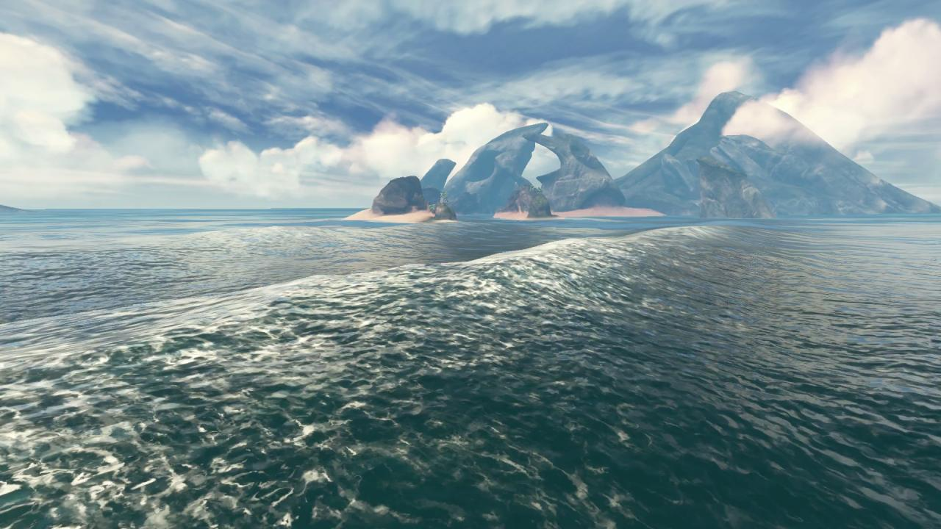
Shading / Foam
Notes:
Foam is generated from the wave crest, and then faded over the coarse of the animation loop.

Slide 91
Shading / Tinting
Deep/shallow water colours
Grayscale “height” value interpolates between three colours
Notes:
Packed into another channel of the costal foam texture map to specify water depths.

Slide 92
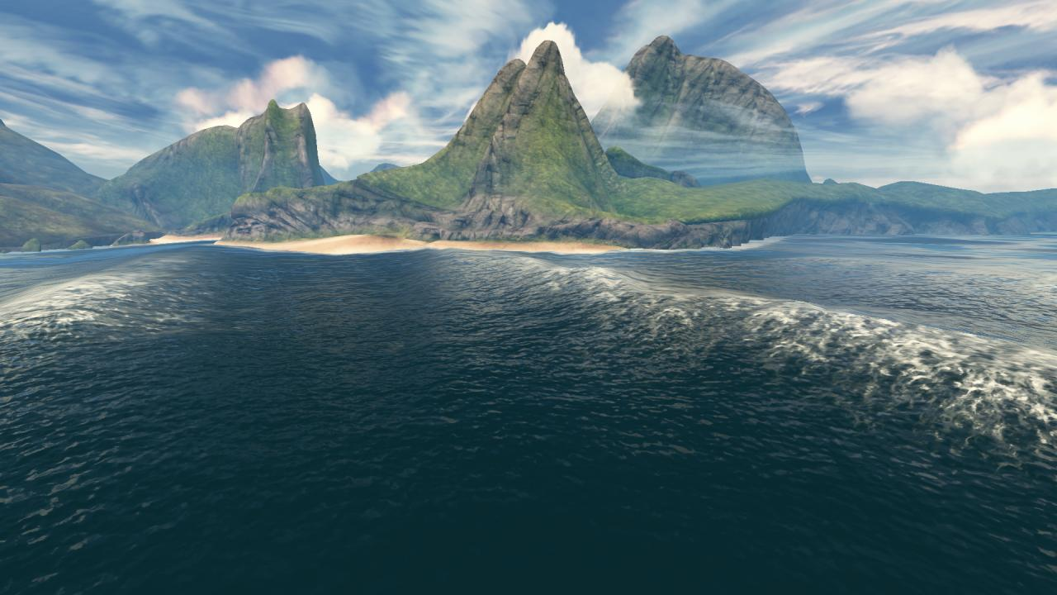
Shading / Tinting
Notes:
Without tinting

Slide 93
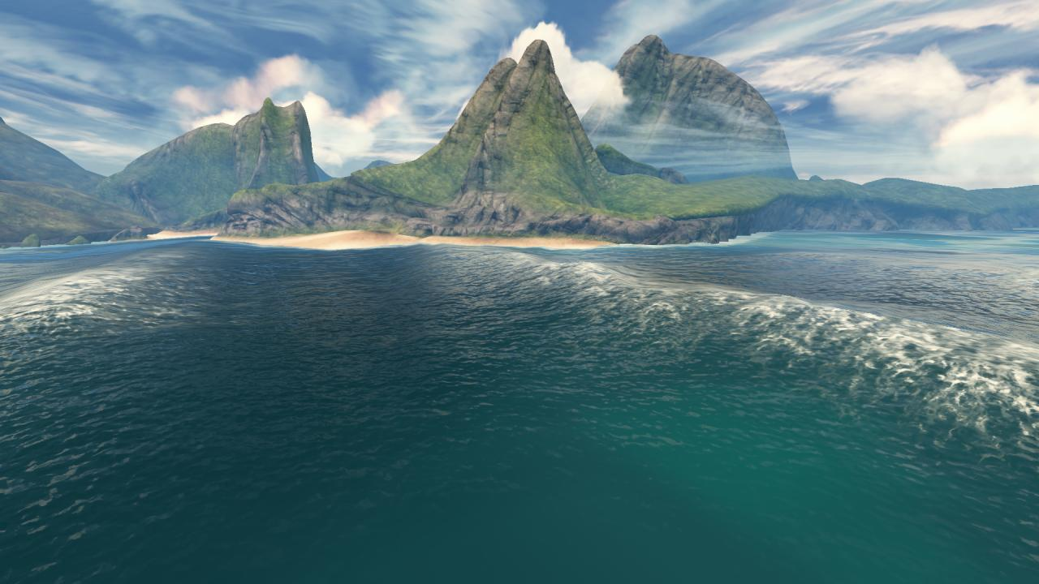
Shading / Tinting
Notes:
With tinting

Slide 94
Shading / SSS
Subsurface scattering similar to [Torres2012]

Slide 95
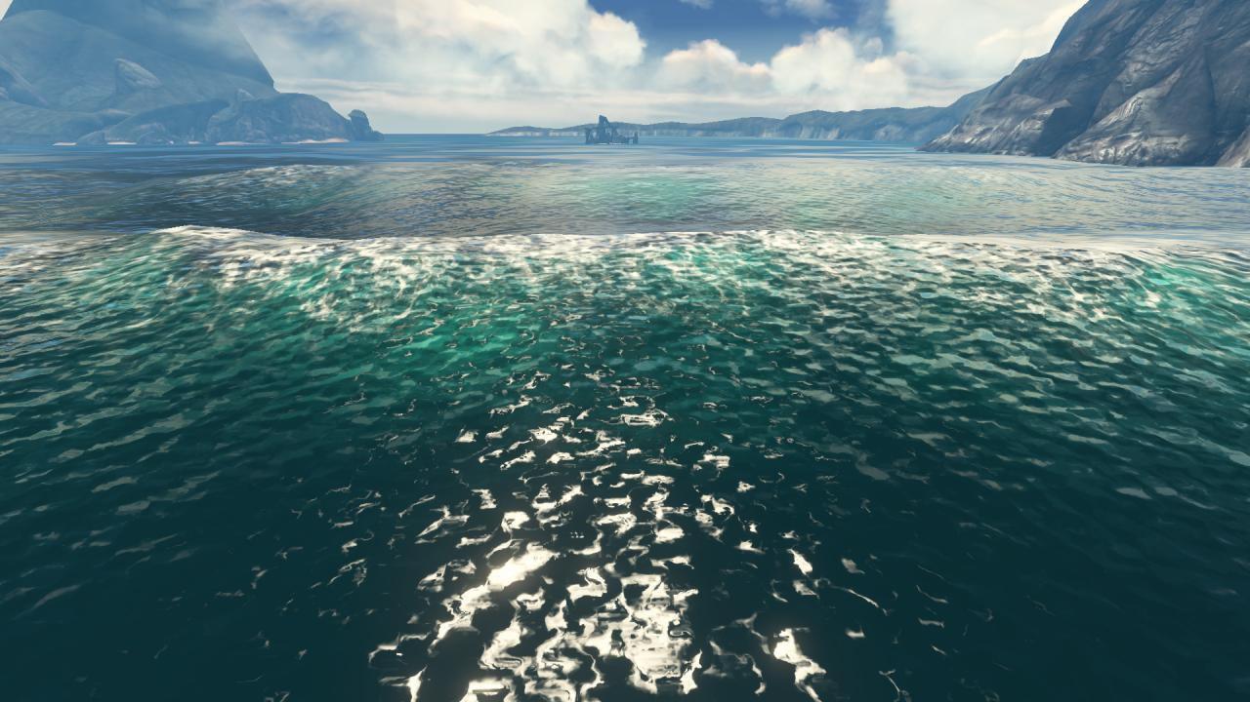
Shading / SSS
Notes:
Exaggerated. See light green/turqoise addition near crests.

Slide 96
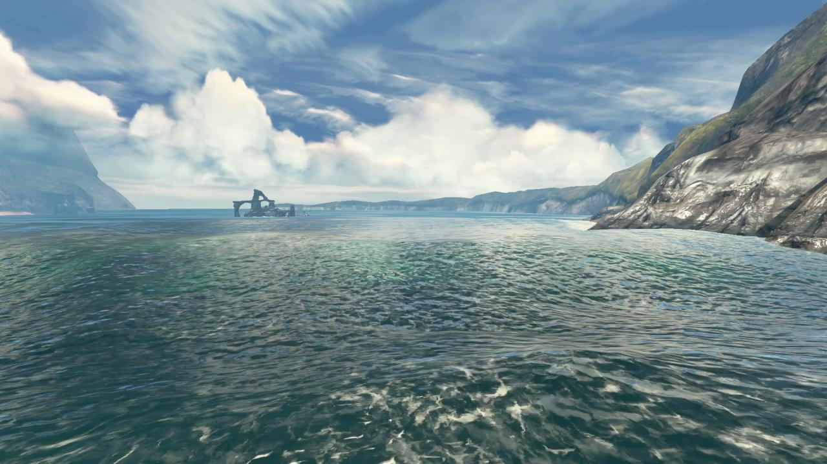
Shading / SSS
Notes:
In motion

Slide 97
Shading
What worked
Foam had huge impact
Deep/shallow colours
What didn’t work
Add high frequency noise in screen space
Fake sunlight direction (due to engine constraints)
Notes:
Foam was the biggest bit of work but was well worth it – we used it for everything that interacts with water.
One thing we spent a bit of time on is to try to add detail to the surface in screen space to give the appearance of choppy waves in the background. It was difficult to get the detail to track properly with the surface and we abandoned it after some time.
We also wanted to fake the sunlight direction for specular shading, to get nice long specular responses across the water without affecting shadows etc. This wasn’t possible for practical reasons.

Slide 98
Conclusion
Shape
Looked at some existing shape descriptions
Introduced Parabolic Waves
Extended wave particles to “ripple particles”
Presented combination of shape descriptions that met visual and design goals in short amount of time

Slide 99
Conclusion
Meshing
Looked at existing techniques (more work req.)
Introduced Polar Meshing
Significant reduction of error
Very suitable for low power devices

Slide 100
Conclusion
Shading
Presented some components that enabled us to get a pleasing aesthetic result in a short amount of time

Slide 101
Conclusion
If we could do it again…
Same implementation for Wii
GPU based Polar Meshing for other platforms

Slide 102
Conclusion
Vertex shader
Take ring distances from CPU?
Tessellation stages
?
Notes:
I havent looked into GPU implementations very deeply.
TODO: Survey GPU methods.

Slide 103
Demos
Notes:
The results from before

Slide 104
Appendix
Sampling trochoids
Sampling displacement maps
Adapting sampling to shape
Parabolic wave equations
Sampling wave particles
Physics considerations
More information about detail curves
Derivation for uniform detail in screen space
Ensuring screen coverage
Additional strategies for stabilizing verts
Refraction notes

Slide 105
Contact
Huw Bowles
huw@studiogobo.com
Studio Gobo is hiring!

Slide 106
References
Edwards J. “Dynamic Sand Simulation and Rendering in Journey”, 2012
Hinsinger D., Neyret F. and Cani M.P. “Interactive Animation of Ocean Waves”, 2002
Losasso F. and Hoppe H. “Geometry clipmaps: Terrain rendering using nested regular grids”, 2004
Ochoa C. G. and Holder D., “Water Technology of Uncharted”, 2012
Tessendorf J. “Simulating Ocean Water”, 2001
Torres G. and Ricour H. “Technical Challenges of Assassin’s Creed III: Real-Time Water Simulation and High-Quality Linear Gameplay Sequences”, 2012
Yuksel C., House D.H., Keyser J. “Wave Particles”, 2007

Slide 107
Appendix

Slide 108
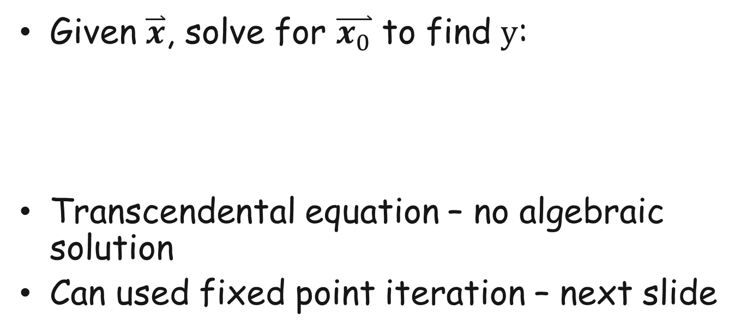
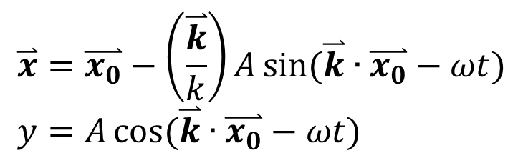
Sampling Trochoids
Given $\overset{⃑}{x}$, solve for $\overset{⃑}{x_{0}}$ to find $y$:
Transcendental equation – no algebraic solution
Can used fixed point iteration – next slide
$$\overset{⃑}{x}=\overset{⃑}{x_{0}}−\left(\frac{\overset{⃑}{k}}{k}\right)A\sin{(\overset{⃑}{k}∙\overset{⃑}{x_{0}}−ωt)} \\ y=A\cos{(\overset{⃑}{k}∙\overset{⃑}{x_{0}}−ωt)}$$
Notes:
Trochoids are nice – peaks are important for visual interest.
Need many trochoids to get satisfactory detail.
More info: http://whatonearth.olehnielsen.dk/oceanwaves.asp
Transcendental equation. No algebraic solution.

Slide 109
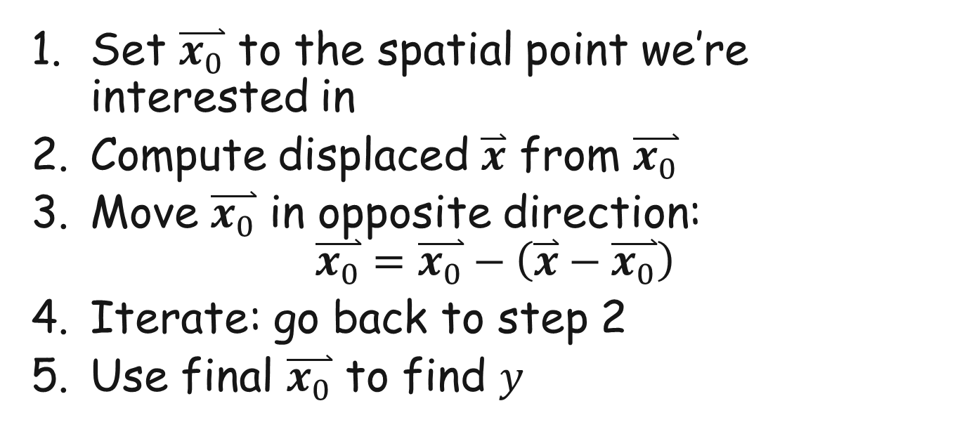
Sampling Trochoids
Set $\overset{⃑}{x_{0}}$ to the spatial point we’re interested in
Compute displaced $\overset{⃑}{x}$ from $\overset{⃑}{x_{0}}$
Move $\overset{⃑}{x_{0}}$ in opposite direction: $\overset{⃑}{x_{0}}=\overset{⃑}{x_{0}}−\left(\overset{⃑}{x}−\overset{⃑}{x_{0}}\right)$
Iterate: go back to step 2
Use final $\overset{⃑}{x_{0}}$ to find $y$
Notes:
Can stop iterating when residual error gets small enough, but in practice I find three evaluations of step 3 is usually enough.
See Yang2012 for a more information and diagrams for fixed point iteration, and Bowles2012 for convergence properties:
Yang L. and Bowles H., “Accelerating Rendering Pipelines Using Bidirectional Iterative Reprojection”, 2012
Bowles H., Mitchell K., Sumner R., Moore J., Gross M., “Iterative Image Warping”, 2012

Slide 110
Sampling Displacement Maps
Exactly the same problem for displacement maps
Surfaces generated by Fourier Synthesis
Use Fixed Point Iteration in a similar way
Step 2 is computed by sampling the displacement map instead of computing the trochoid equation

Slide 111
Adapting Sampling to Shape
Notes:
In general we want the sampling to adapt to the local frequency content of the shape. Put simple, regions of high curvature should get a concentration of samples compared to smoother areas. Here we will show how we did this for parabolic waves but the same analysis is applicable to wave particles etc.
Regular sampling is agnostic to wave curvature. This diagram doesn’t really illustrate the extent of the problem. Typically we’ll get sample points that miss the crest of the wave completely.

Slide 112
Adapting Sampling to Shape
Notes:
To address this we take the input value and lerp it towards smoothstep. This will help to shift sample points to the start and end of the domain.

Slide 113
Adapting Sampling to Shape
Notes:
This yields a displacement map which will pinch verts to give crisp wave crests. This has the important property that all sample points lie on the curve, so that wave height queries can be performed efficiently (this will be discussed later).

Slide 114
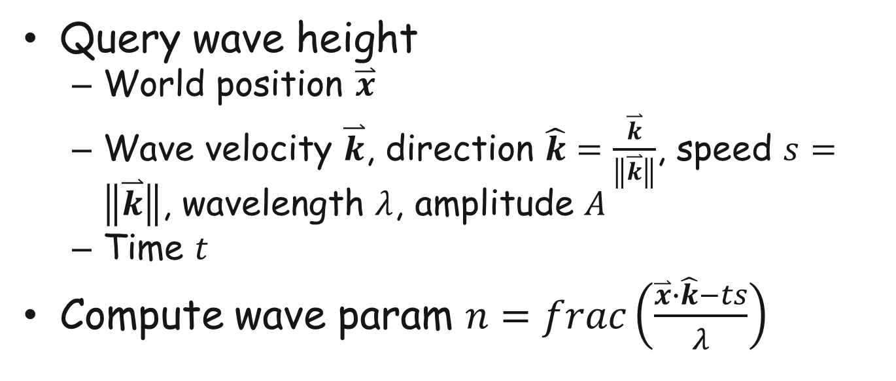
Parabolic Wave Equations
Query wave height
World position $\overset{⃑}{x}$
Wave velocity $\overset{⃑}{k}$, direction $\hat{k}=\frac{\overset{⃑}{k}}{\left\|\overset{⃑}{k}\right\|}$, speed $s=\left\|\overset{⃑}{k}\right\|$, wavelength $λ$, amplitude $A$
Time $t$
Compute wave param $n=frac\left(\frac{\overset{⃑}{x}∙\hat{k}−ts}{λ}\right)$
Notes:
Can compute wave speed s from lambda using dispersion relation for deep water waves: angular freq w=root(gk) where g is gravity and k is the root number 2pi/lambda
Want n to be 0-1; add 1 if its negative.
[This is a translation of the code/excel equations, let me know if I’ve made a mistake]

Slide 115
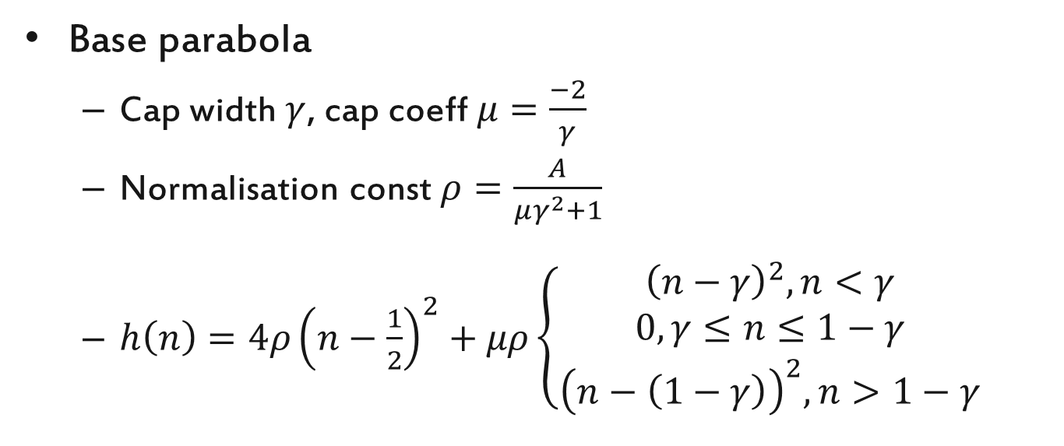
Parabolic Wave Equations
Base parabola
Cap width $γ$, cap coeff $μ=\frac{−2}{γ}$
Normalisation const $ρ=\frac{A}{μγ^{2}+1}$
$h\left(n\right)={4ρ\left(n−\frac{1}{2}\right)}^{2}+μρ\left\{\begin{aligned}{\left(n−γ\right)}^{2},n<γ \\ 0,γ≤n≤1−γ \\ {\left(n−\left(1−γ\right)\right)}^{2},n>1−γ\end{aligned}\right.$
Notes:
[This is a translation of the code/excel equations, let me know if I’ve made a mistake]

Slide 116
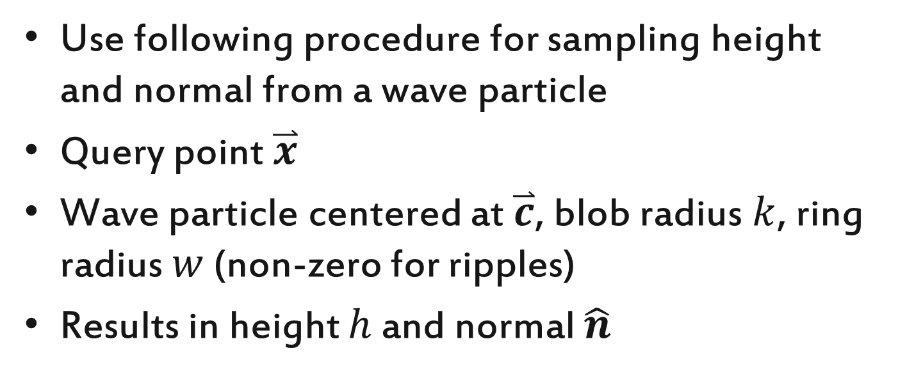
Sampling Wave Particles
Use following procedure for sampling height and normal from a wave particle
Query point $\overset{⃑}{x}$
Wave particle centered at $\overset{⃑}{c}$, blob radius $k$, ring radius $w$ (non-zero for ripples)
Results in height $h$ and normal $\hat{n}$

Slide 117
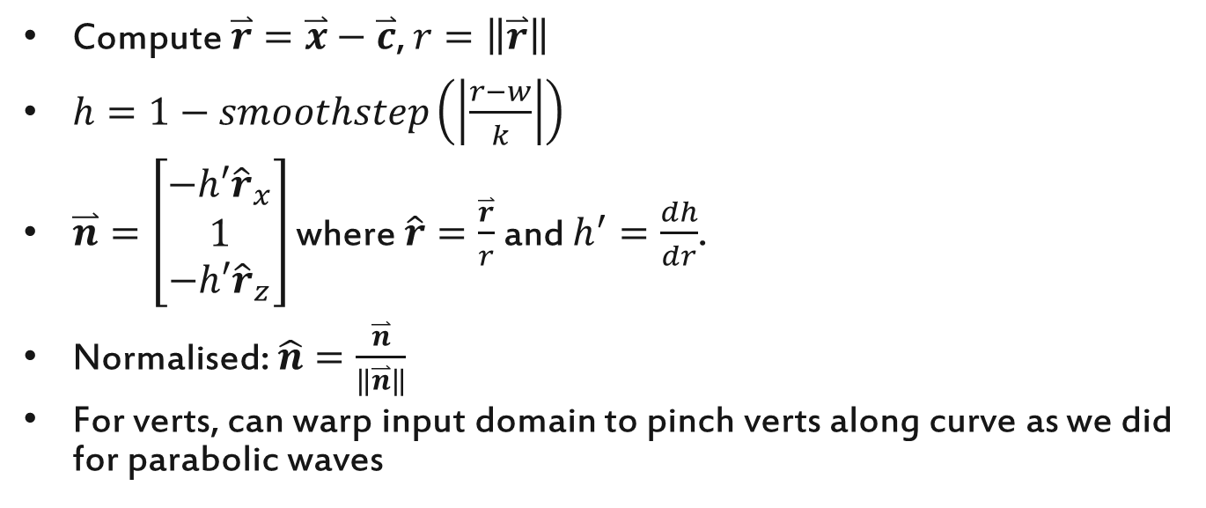
Sampling Wave Particles
Compute $\overset{⃑}{r}=\overset{⃑}{x}−\overset{⃑}{c}$, $r=\left\|\overset{⃑}{r}\right\|$
$h=1−smoothstep\left(\left|\frac{r−w}{k}\right|\right)$
$\overset{⃑}{n}=\left[\begin{matrix}−h′{\hat{r}}_{x} \\ 1 \\ {−h′\hat{r}}_{z}\end{matrix}\right]$ where $\hat{r}=\frac{\overset{⃑}{r}}{r}$ and $h^{′}=\frac{dh}{dr}$.
Normalised: $\hat{n}=\frac{\overset{⃑}{n}}{\left\|\overset{⃑}{n}\right\|}$
For verts, can warp input domain to pinch verts along curve as we did for parabolic waves
Notes:
There are some easy optimisations. Compute the squared length r^2 of r, then early out if it is greater than k^2. Subsequently we can use r^2 when evaluating the smoothstep function and its derivative.
[This is a translation of the code, let me know if I’ve made a mistake]

Slide 118
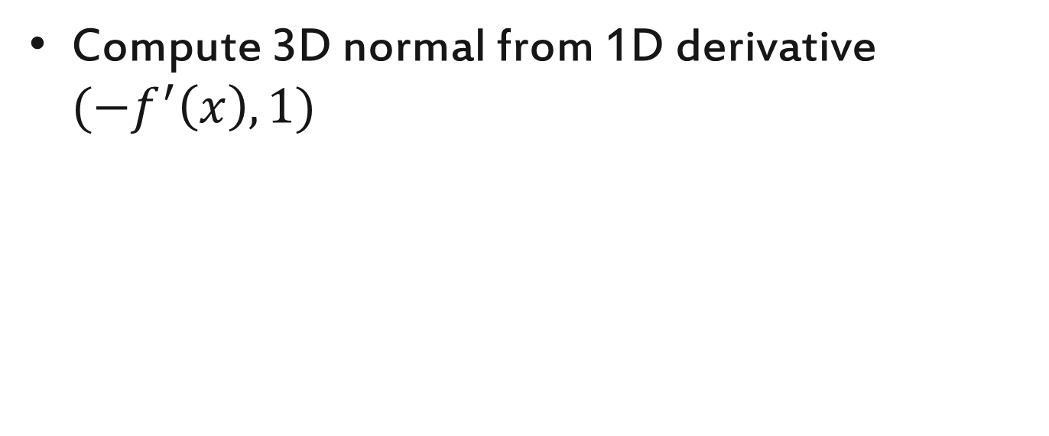
Sampling Wave Particles
Compute 3D normal from 1D derivative ${(−f}^{′}\left(x\right),1)$

Slide 119
Sampling Wave Particles
To sum multiple wave particles
Add together the heights
Add together the x and z components of the normal (the y component stays at 1)
Normalise normal

Slide 120
Physics Considerations
Wave data used directly for physics
Floating objects on a rotational spring
Use 4X downsampled normals
This gave us direct control over the floating behavior, to limit rotational extents and velocities
Sacrifices some physicality of the floating
Not a priority for us – our target demographic is a younger audience, so we went for an arcade feel

Slide 121
Physics Considerations
Physics and ocean mesh shape need to match
This was a big challenge for us due to the low detail in the ocean mesh
We got reasonable results tweaking parameters but did not completely solve this

Slide 122
Physics Considerations
Paradox in multiplayer
If floating physics is view dependent, which view should the physics conform to when there are two viewpoints?
We had split/screen multiplayer but players travel around the world together, so viewpoints could not diverge
In general a solution might be to use the surface mesh height for the floating physics – this would eliminate divergence

Slide 123
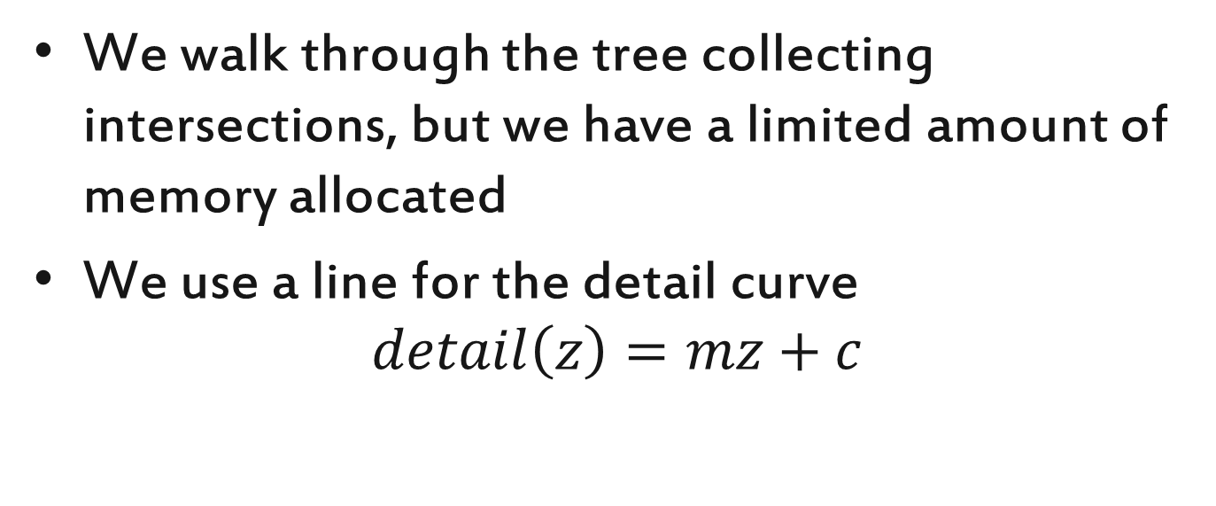
Detail Curve
We walk through the tree collecting intersections, but we have a limited amount of memory allocated
We use a line for the detail curve
$$detail\left(z\right)=mz+c$$

Slide 124

Detail Curve
In this case we expect to encounter $\frac{1}{m}$ intersections per tree level on average. We can therefore approximate the number of intersections expected
$$N≅\frac{1}{m}\left(\log_{2}\left(detail\left(z_{far}\right)\right)−\log_{2}\left(detail\left(z_{near}\right)\right)\right)$$
$$≅\frac{1}{m}\log_{2}\left(\frac{detail\left(z_{far}\right)}{detail\left(z_{near}\right)}\right)$$
Notes:
This assumes that the end points of the line lie exactly on tree levels i.e. log2 is returning an integer. If not then the residue at the front and back need to be added as the proportion of the tree level crossed multiplied by 1/k.

Slide 125
Detail Curve
Could use a hill climbing optimisation to find line parameters to produce the right number of intersections

Slide 126

Detail Curve
Can derive analytical detail curve to provide uniform detail in screen space
$detail\left(z\right)=\frac{ds}{hf}{\left(zC−hS\right)}^{2}$
This gives a continuous detail level, whereas the tree gives discrete levels. Therefore a bias is required (either fixed or obtained through a simple optimisation)
Notes:
TODO – add derivation.

Slide 127
Detail Curve
Notes:
Blue shows the screen-space uniform detail
Red shows the gradient of this curve
In our experiments we split the parabola at boundaries between tree levels and used linear approximations within each level. This allowed us to use the same intersection code as before (line-line instead of line-parabola)

Slide 128
Detail Curve
Problem!
Gradient of tree branches: -2, +2
When gradient of detail curve parabola crosses +2, intersection points will pop in at this point in the parabola. This is intrinsic to the structure of the tree.
Notes:
When the gradient of the parabola crosses two, it results in a point on the parabola curve that will touch tree branches first (before the rest of the parabola). At this point vert rings will ‘pop’ into existence, which is visible and disturbing to the viewer.

Slide 129
Detail Curve
We wanted to implement a piecewise linear curve that better approximates the uniform detail parabola
Additionally we wanted to set up different detail profiles for different scenes and interpolate between them
Allow high detail over short distance for inland areas to allow for detailed ripples etc
Ran out of time ☹

Slide 130

Meshing / Screen Coverage
Frustrum creates non-trivial shape
Need to ensure coverage by mesh, both globally (below) and locally (next slide)
Notes:
Ideally, take foot print of view frustrum on plane, use it to compute focal point of vert rings
We did not master this, we used some simple heuristics to move the focal point backwards based on viewing angle and height

Slide 131
Meshing / Screen Coverage
Verts displaced horizontally, which can cause issues at sides of screen
Used slightly enlarged FOV to help here
Simply pinning verts at sides can cause UV stretching
Can use fixed point iteration to find locations that will be displaced to screen edge, to compute correct UVs
Notes:
So we can pin verts at the side of the screen to make sure they aren’t displaced into the frustum. However we need to know where the vert is coming from, because we compute Uvs for the vert based on its undisplaced position. This gives the correct feeling of the surface being displaced horizontally as waves pass.
Figuring out where the vert is coming from needs to be found via search/iteration in general. Fixed point iteration works well for this, see the previous slides (sampling trochoids). Note that this needs to be done just for the edge verts.

Slide 132

Meshing / Polar Meshing
Strafing
Notes:
We have similar issues of verts moving in world space when the camera strafes.

Slide 133

Meshing / Polar Meshing
Pin a particular radius
Notes:
To combat this we can rotate the mesh as the camera strafes. We need to pick a radius to keep stationary. This is typically in the mid ground (the foreground is highly tessellated, and there wasn’t much shape in the background for us).

Slide 134

Meshing / Polar Meshing
Pin a particular radius
Notes:
We still get movement of the vert but potentially less.

Slide 135
Refraction
Offset is simple nudge based on surface normal
Check if we’re sampling foreground object, if so sample background
Could have scaled offset by depth but result was good enough

